Slide 1
CO4127
Lecture 3 - Introduction to CSS

Slide 2
Today
A brief history of CSS
Getting started with CSS
Hooking our CSS up to our HTML
What is ‘cascading’?
Specificity
CSS Rule structure
Selectors
Basic selectors
Classes and IDs
Classes
IDs
Notice about Classes and IDs
Properties
Properties
Common properties
Fonts
Color
Comments
Browser Compatibility

Slide 3
A brief history of CSS

Slide 4

A brief history of CSS
CSS stands for Cascading Style Sheets
Style Sheet Language
Describes the presentation of markup (eg. HTML)
Invented by Håkon Wium Lie and Bert Bos
Initially released in December 1996 (20 years ago)
First draft of CSS 3 submitted in 1999
Current version: 3 (CSS3)
CSS is a living standard
CSS 3 is still a working draft, after 17 years of development

Slide 5
Getting started with CSS

Slide 6
Hooking CSS up to our HTML
CSS comes in 3 forms:
External
Embedded
Inline
Always use external CSS. Always.
External CSS is so called because it lives in an external file or files.
A HTML document can contain one or more CSS files.
The order that they are loaded in is important! (More on that later)
CSS is imported with the <link> tag and should only exist inside <head>.
Here’s a common example:
CSS
<link rel="stylesheet" type="text/css" href="css/style.css">

Slide 7
What is ‘cascading’?
When you write CSS to update the appearance of a <h1> you might have several rules that try to change its colour. But which wins? To the untrained eye, it must look like a big argument.
It all comes down to the specificity of your CSS rules.

Slide 8
Specificity
Some CSS rules are more specific than others, by cascading down from more general rules to those with higher specificity, the browser can compute which styles to use.
The browser will always choose the most specific rule it can find.
If it finds that there are multiple rules with the same specificity, it will choose the rule that was defined last (ie. later in the file). This is why the order that you include your CSS files is important!

Slide 9
CSS Rule structure
Every CSS rule will follow this basic structure:
selector {
property: value;
}
CSS
For example, to target every <p> on a page and change their text colour to red, you could use:
CSS
p {
color: red;
}
Rules are surrounded by matching curly braces {}, known as a declaration block. Every property is delimited by a colon : and ends with a semicolon ;.

Slide 10
Selectors

Slide 11
Basic selectors
There are lots of different ways to target elements in your HTML. A selector is responsible for selecting which elements to apply a set of styles to. Here are some basic ones to get you started:
Element Selector: a Selects all <a> elements
Group Selector: h1, h2 Selects all <h1> elements and all <h2> elements
Descendent Selector: nav ul Selects all <ul> elements inside all <nav> element

Slide 12
Classes and IDs
When you start building complex nested HTML structures, you will want to get away from using selectors like this as soon as possible because you’ll find they are limiting and end up becoming complex to write:
CSS
nav ul li a i {
display: block;
width: 40px;
height: 40px;
}
If you end up with multiple identical structures which require different styles, you cannot get away with just using basic selectors. You need to use Classes or IDs.

Slide 13
Classes
A class selector is useful if you want to apply styles to one or more elements by using a name of your choice. They are denoted by a leading period.
Class Selector: .menu Selects all elements with a class attribute of menu
.button {
display: block;
padding: 20px;
color: white;
}
.green {
background-color: green;
}
.red {
background-color: red;
}
<nav>
<ul>
<li>
<a class="button green" href="#">Save</a>
</li>
<li>
<a class="button red" href="#">Cancel</a>
</li>
</ul>
</nav>
CSS
HTML

Slide 14

Output
The code from the pervious slide will give us two buttons similar to this below

Slide 15
IDs
An ID selector is useful if you want to apply styles to a single element by using a name of your choice. They are denoted by a leading hash.
ID Selector: #logo Selects the first element with an id attribute of logo
CSS
#logo {
display: block;
width: 100px;
height: 25px;
margin: 25px 25px 25px 50px;
background-image: url(img/bg.png);
background-size: 100px 25px;
background-repeat: no-repeat;
}
<header>
<a id="logo" href="#"></a>
<nav>
<!-- Nav goes here -->
</nav>
</header>
HTML

Slide 16
Notice about Classes and IDs
Please note the important difference between classes and IDs:
Classes can be used by one or more elements
IDs can only be used once in any HTML document.
Classes are useful for elements which occur multiple times throughout your website.
IDs are useful for one-off elements or a single element that appears on every page of a site, for example a logo.
When in doubt, or as convention, use classes in CSS instead of IDs.

Slide 17
Properties

Slide 18
Properties
A CSS property appears inside the declaration block of a CSS rule. For example, this rule has one property:
There are 369 CSS properties, 355 of which are allowed in CSS 3.
You will never need to know or use all of them but your repertoire will grow as you practice and build more things.
The only way to learn what they are and what they do is to experiment with them.
CSS
.token {
width: 10px;
}

Slide 19
Some common properties
Font-family
Font-size
Color
Margin
Background-color
Text-align
Height / Width
Border
Padding

Slide 20
Fonts
You can access any device font from CSS but beware that if a user does not have a certain device font, you will need to supply a common fallback.
In this case, if a user does not have Calibri on their device, the browser will instead try to load sans-serif. The value of the font-family property is one of very few that is comma delimited.
You can change the font size on an element and its children with the font-family property. Common units are pt (point), px (pixels) and em (relative size - 2em means 2 times the size of the current font).
Because it’s difficult to find a device font everyone will have, it’s now possible to load web fonts. For more information and instructions on how to import web fonts, check out fonts.google.com.
CSS
body {
font-family: Calibri, sans-serif;
}

Slide 21
Color
First off, notice the name, it’s the american spelling. CSS colours can be specified in the following formats:
140 standardised colour names eg. Gainsboro, blue
Hexadecimal values eg. #DCDCDC
RGB / RGBA values eg. rgb(220,220,220) or rgba(220,220,220,1)
HSL / HSLA values eg. hsl(0,0,86) or hsla(0,0,86,1)
CSS
.color-picker-gainsboro {
color: Gainsboro;
color: #DCDCDC;
color: rgb(220,220,220);
color: rgba(220,220,220,1);
color: hsl(0,0,86);
color: hsla(0,0,86,1);
}

Slide 22
Comments

Slide 23
Comments
CSS comments look slightly different to HTML comments.
Comments in HTML are generally not needed but in CSS they can be a great tool not only for learning but also for laying out your code if your stylesheet is getting large.
They open with /* and close with */
/* This is a single line CSS comment */
/*
This is a multi-line
CSS comment
*/
/* ----- (╯°□°）╯︵ ┻━┻ ------ *\
|* *|
|* This is a still valid comment! *|
|* Emoji comments ftw! *|
|* */
\* ------ ┬──┬ ノ( ゜-゜ノ) ------ */
/*
¯\_(ツ)_/¯
This code broke something. Fix.
*/
CSS

Slide 24
Browser Compatability

Slide 25
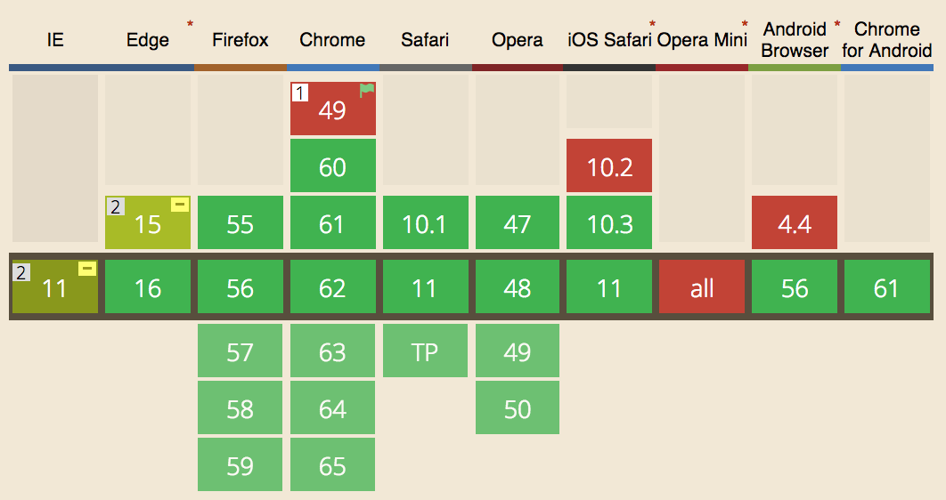
Browser Compatibility
Although CSS is a standard, different browser vendors handle various CSS rules and properties differently.
Therefore, if you notice any inconsistencies, or you want to use a bleeding-edge feature, make sure you check caniuse.com which will show you which browsers support that feature and any extra code you need to implement it on older browsers.
Screenshot from ‘Can I Use’ showing the compatibility table for the bleeding-edge CSS Grid Layout module.

